Slide 1
Scale and Performance in a Distributed File System
John H. Howord et. al.
in ACM Transactions on Computer Systems Vol. 6, No. 1, 1988
Presented by Chulhun Han, Kyoseung Koo

Slide 2
Presentation Outline
Andrew File System Prototype
Overview of Andrew File System (AFS)
Performance Evaluation Of AFS Prototype
Changes For Performance
Revised Andrew File System
Effect of Changes For Performance
Performance Comparison of NFS and AFS
Changes for Operability
Conclusion

Slide 3
Part 1.
Andrew File System Prototype

Slide 4
Andrew File System(AFS)
Distributed File System developed in CMU
Multiple users share server’s files and storage resources
Server-client architecture system.
Presents a homogeneous, location-transparent file name space to all the clients
Caching in Distributed File System
Reduce network traffic and server contention
Whole-file caching
Scalability is most important design goal of AFS

Slide 5
Andrew File System Architecture
Workstations (Client)
Servers
Workstation
It's disk capacity about 800 ~ 1,200MB
They holds all files.
Server received a request for fetch and store a file.
Workstation
It's disk capacity about 65MB!
It caches the files from server
If a client needs a file, it fetch from server and save it as a local copy, called cache.
Workstation

Slide 6
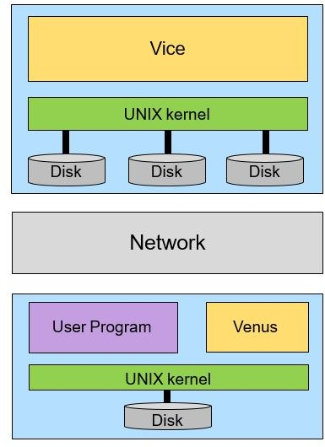
Andrew File System Prototype
Vice (Server)
A process running on server side
Serve files to Venus
essential functions like integrity, availability or security
Vice process dedicated to each Venus client
Venus (Client)
A process running on client side
Cache files from Vice
Contacts Vice only when a file is opened or closed
Reading and writing are performed on the cached copy(client side)
For major functions - open(), close(), read(), write()

Slide 7
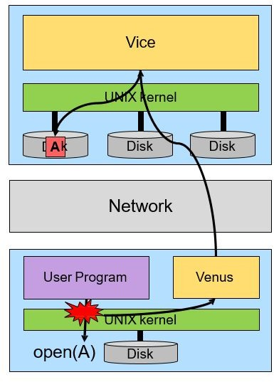
Andrew File System Prototype(open)
User process request to open File A
User kernel intercept file system calls and forward them to Venus
If client doesn’t have the file A in local disk, Venus connect to Vice to cache file A
If client has the file A in local disk,
Venus connect to Vice to check the cache validation.
After fetching file A from Vice,
User process read/modify the file A in local disk

Slide 8
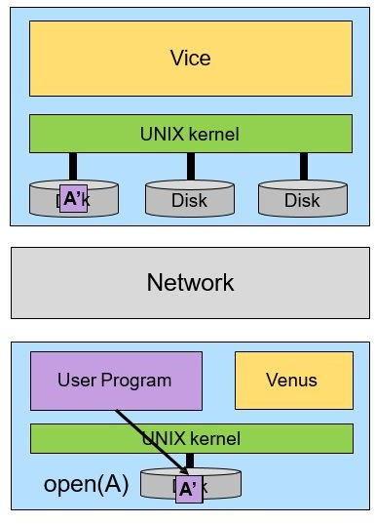
Andrew File System Prototype(save)
User process modified the file(A →A’)
User kernel intercept file system calls and forward them to Venus
Venus connect to Vice, Vice update file
Venus only connects to Vice when open() and close()

Slide 9
Characteristic of the Andrew File System
Process management
Directory hierarchy
File naming
Cache validation check

Slide 10
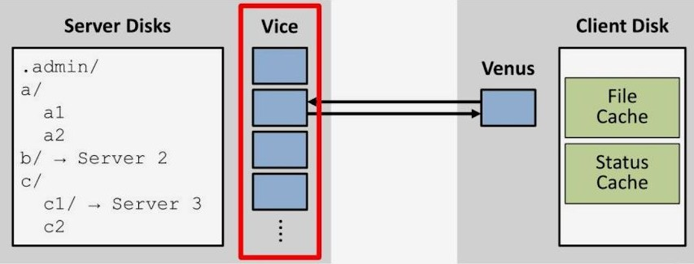
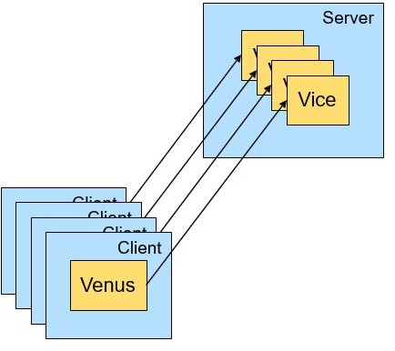
Characteristic of the Andrew File System
- 1. Process management
Dedicated processes
Vice(server) has one process for each Venus(client)
The dedicated process persists until its client terminated
Too frequent context switching
Cannot share address spaces between processes
→ Communication between processes takes place via file in file system

Slide 11
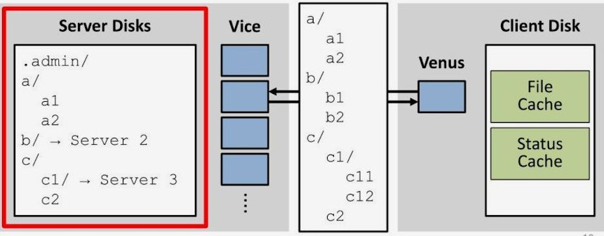
Characteristic of the Andrew File System
- 2. Directory hierarchy
Preserve directory hierarchy
.admin directory stores configuration data
Each servers contained a directory hierarchy mirroring the structure of the Vice files
Stub directory gives a name space located on other servers
If file is not on a server, the search for its name would end in a stub directory

Slide 12
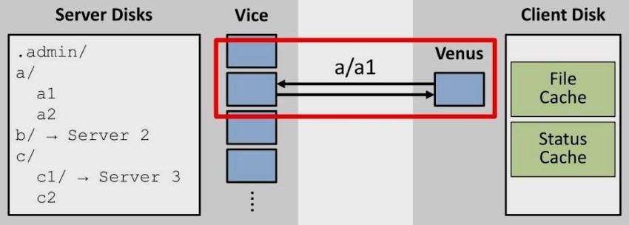
Characteristic of the Andrew File System
- 3. File naming
Vice-Venus interface names files by their full pathname
Kernel maps pathnames to inode(namei).
namei is one of the most heavily used and time consuming parts of the kernel
This makes considerable CPU overhead on the servers and is an obstacle to scaling.

Slide 13
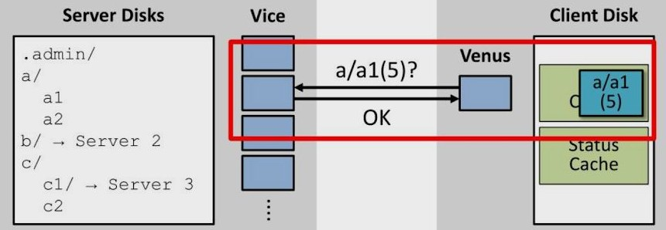
Characteristic of the Andrew File System
- 4. Cache validation check
Venus verify timestamps on every open
Each open include at least one interaction with a server
Even if the file were already in the cache and up-to-date.

Slide 14
AFS Prototype Benchmark Setup
Synthetic Benchmark
A command script for source files
Multiple clients run the benchmark simultaneously
MakeDir → Copy → ScanDir → ReadAll→Make

Slide 15
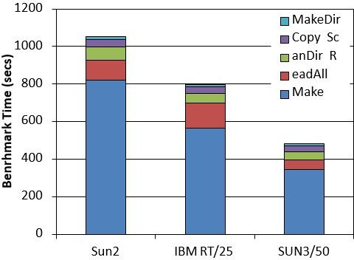
Stand-alone Benchmark Performance
BenchMark takes about 1000 seconds in local disk
MakeDir: Constructs a target subtree that is identical in structure to the source subtree
Copy: Copies every file from the source subtree to the target subtree
ScanDir: Recursively traverses the target subtree and examines the status of every file in it
ReadAll: Scans every byte of every file in the target subtree once
Make: Compiles and links all the files in the target subtree
MakeDir
Copy
ScanDir
ReadAll
Make

Slide 16
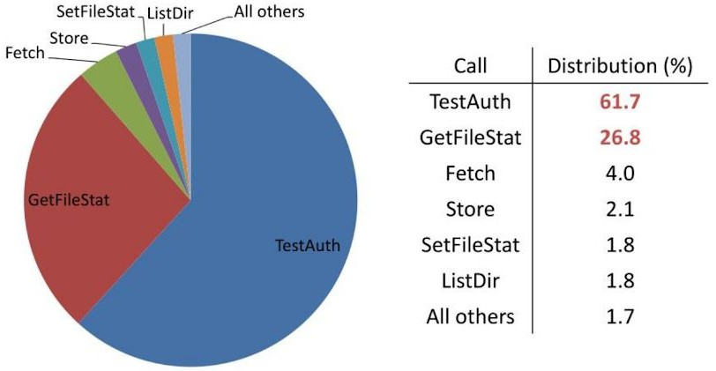
Distribution of Vice Calls in Prototype
In distribution of Vice calls in prototype on average,
TestAuth and GetFileStat are accounting for nearly 90% of the total calls!
TestAuth call is used to validate cache entries
GetFileStat obtaine status information about file absent from the cache
Caused by frequency of cache validity check(timestamp check)

Slide 17
Prototype Benchmark Performance
A Load Unit = about five Andrew users
Load unit | overall benchmark time |  | time per testAuth call
 | absolute(s) | relative(%) | absolute(s) | relative(%)
1 | 1739(3) | 100 | 87(0) | 100
2 | 1894(4) | 106 | 118(1) | 136
5 | 2747(48) | 154 | 259(16) | 298
8 | 5129(177) | 287 | 670(23) | 770
10 | 7326(69) | 410 | 1050(13) | 1207
Took about 70% longer at a load of 1 than in the stand-alone case
TestAuth rise rapidly beyond a load of 5
A server load between 5 and 10 was the maximum feasible

Slide 18
Prototype Server Usage
server | Utilization(%)
 | CPU | Disk 1 | Disk 2
cluster 0 | 37.8 | 12.0 | 6.8
cluster 0 | 12.6 | 4.1 | 4.4
cmu-0 | 7.0 | 2.5 | -
cmu-1 | 43.2 | 13.9 | 15.1
CPU utilization is too high!
Server CPU is the performance bottleneck
Caused by frequent context switching
Traversing full pathnames
Server loads were not evenly balanced
Require load balancing between servers

Slide 19
Have to improve ...
Process management
Because of so many processes, context switching happens frequently
Need to use files in filesystem to communicate between processes
File naming
Servers spend times to mapping full pathnames to inode
Because of the using full pathnames, file movement between servers is impossible.
Cache validation check
Even if the file were already in the cache and up-to-date, we have to check timestamp.
We need to reduce timestamp check!

Slide 20
Part 2.
Revised Andrew File System

Slide 21
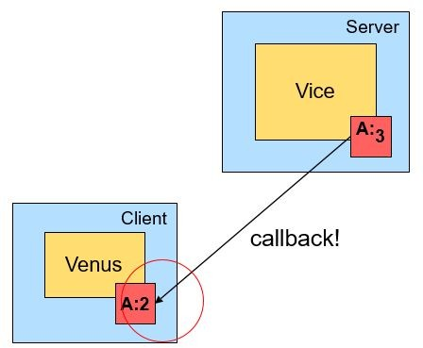
Changes for Performance
Cache validation check
Remove always-causing cache validation check. (for entire open() and close())
Instead, it adopts the callback mechanism.
If someone trying to modify a file
A:2
Callback
Venus assumes that cache entries are valid unless otherwise notified.
It reduces # of cache validation checks.
Venus requests to server after a file is invalidated.
The server promises to notify it before allowing modification by any other workstation.

Slide 22
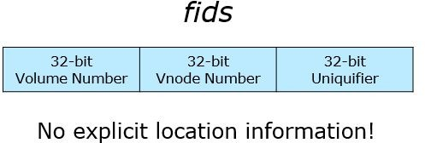
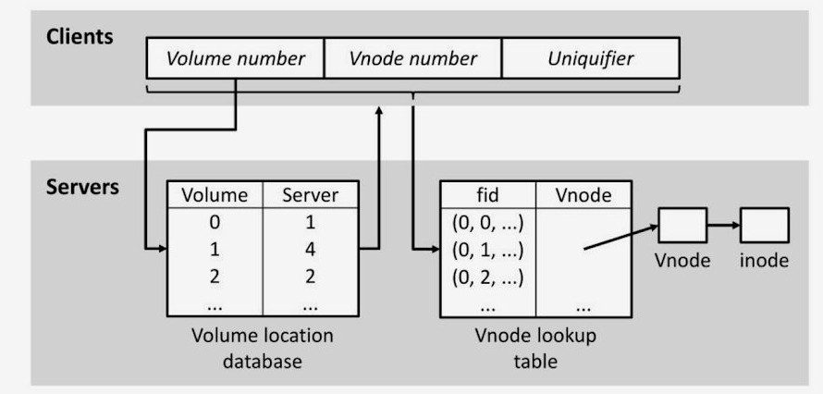
Changes for Performance
File naming (name resolution)
Now a client holds fids, not pathnames.
It locate a file by a fid which is a identification of a file.
Introduce fids (96-bits long)
32-bit Volume Number
Collection of files located on one server.
32-bit Vnode Number
Used as an index into an array containing the file storage information for the files in a sing volume.
32-bit Uniquifier
Allows reuse of vnode numbers.
Volume Location Database
A client now needs to know which server has the volume.
Every server replicates it to serve the volume's location.

Slide 23
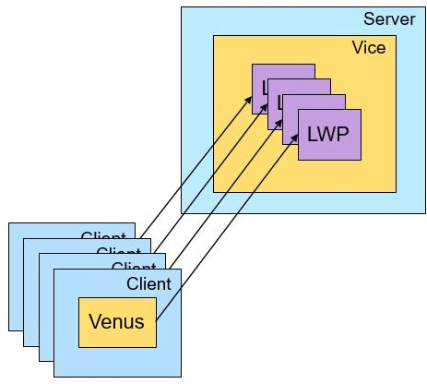
Changes for Performance
Process management
Now a single process to service all clients of a server.
It uses multiple Lightweight Processes (LWPs) within one process.
One of the features of LWP is a cheap context switch.
It makes multithreading low-overhead.

Slide 24
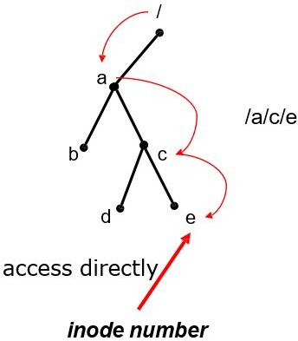
Changes For Performance
- This is replaced with file naming.
Low-Level Storage Representation
Access files by their inodes rather than by path names
Eliminated nearly all pathname lookups on workstations and servers

Slide 25
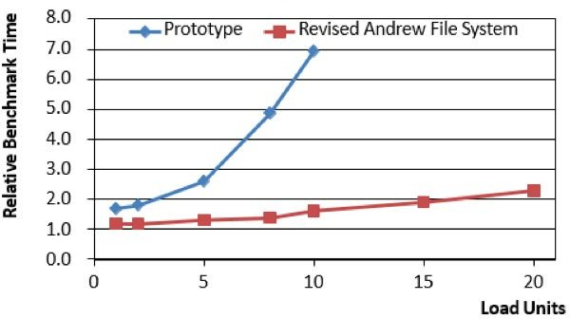
Revised AFS Benchmark Result
The design changes have improves scalability considerably.
= about five Andrew users
Comparison of prototype and Revised AFS

Slide 26
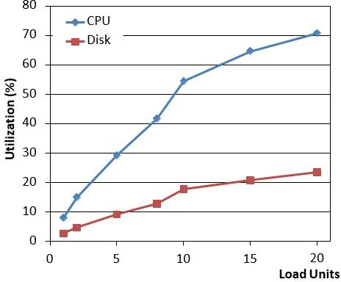
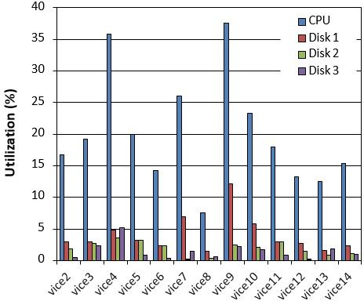
Revised AFS Benchmark Result
Server utilization during the benchmark
- For better performance, server needs more efficient software or faster CPU
Andrew Server Usage
- Most of servers show CPU utilizations between 15% and 25%

Slide 27
Comparison with
A Remote-Open File System
Caching of entire file in the local disks of AFS was motivated by:
Whole-file transfer contacts servers only on opens and closes, read-writes cause no network traffic.
Caching of entire files simplifies cache management.
It can also uses efficient bulk data transfer protocols.
Minimize server intervention by contacting server only on open / close.
No network traffic on read / write.
It also alleviates server overhead.
AFS does scale well. How about the other distributed file systems?

Slide 28
Comparison with
A Remote-Open File System
Distributed File Systems: Sun Microsystem NFS, AT&T RFS, Locus
The data in a file are not fetched at all.
=> Not whole-file transfer
Instead, the remote site potentially participates in each individual read and write operation.
Even though buffering and read-ahead are used to improve performance but the remote site is still conceptually involved in every I/O.
=> Not engaging only in open() and close().

Slide 29
Comparison with
A Remote-Open File System
Sun Microsystem's Network File System (NFS)
Page caching: NFS caches inodes and individual pages of a file in memory.
Once a file is open, the remote site is treated like a local disk with read-ahead and write-behind of pages
Consistency semantics of NFS
A new file may not be visible elsewhere for 30 seconds.
Two processes writing to the same file could produce a different results.

Slide 30
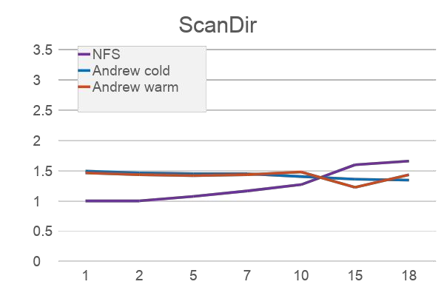
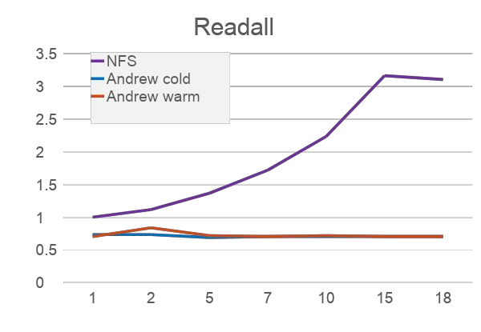
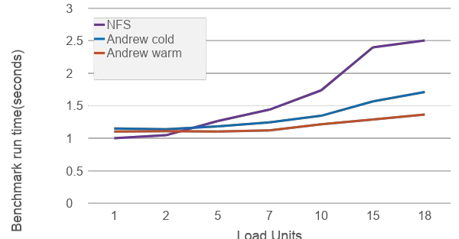
Comparison with
A Remote-Open File System
Comparison of AFS and NFS
NFS's performance degrades rapidly with increasing load.
Andrew well scales especially on ScanDir and ReadAll than NFS.

Slide 31
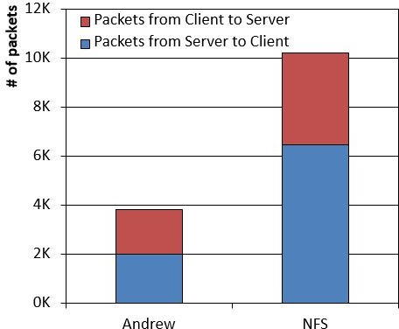
Comparison with
A Remote-Open File System
Network Traffic
NFS generates nearly three times as many packets as Andrew at a load of one.

Slide 32
Comparison with
A Remote-Open File System
Most part of experiment results beats NFS.
Alleviation on server load boosts AFS's scalability.
Drawbacks of the entire file caching approach in AFS
Files that are larger than the local disk cache cannot be accessed at all.
Strict emulation of 4.2BSD concurrent read and write semantics across workstations is impossible.

Slide 33
Changes for Operability
Authors operates AFS several months in CMU.
Some practical lessons motivates introducing of Volume.
Volume improves operability of AFS.
Goal: to build a system that would be easy for a small operational staff to run and monitor with minimal inconvenience to users
Problems in the prototype: inflexible mapping of Vice files to server disk storage.
Vice was constructed out of collections of files glued together by the 4.2BSD Mount mechanism
Movement of files across servers was difficult.
It was not hard to apply a quota system, backup utilities, and replication.

Slide 34
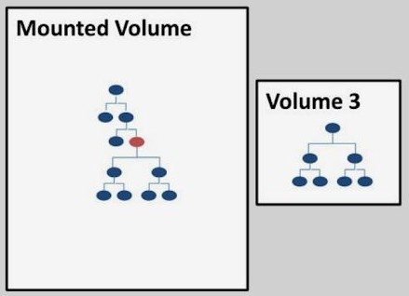
Changes for Operability
Volume
Collection of files forming a partial subtree of the Vice name space.
Volumes are glued together at Mount Points.
Volumes provides a level of Operational Transparency.

Slide 35
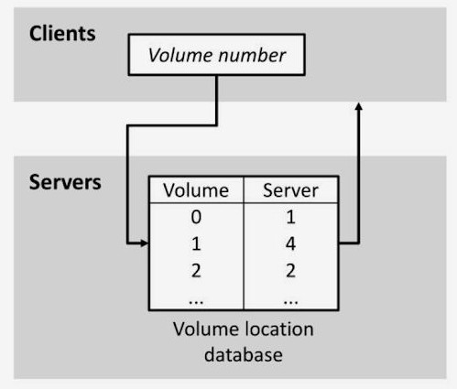
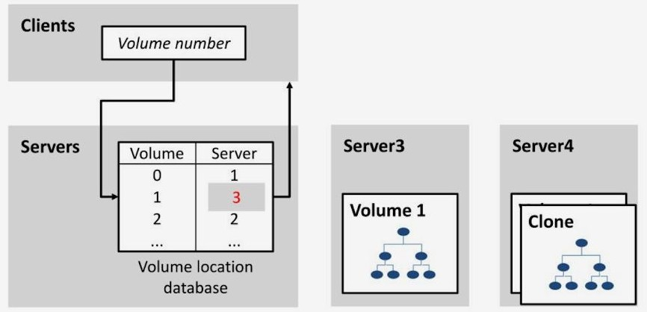
Changes for Operability
Volume Movement
Volume movement is done by creating a frozen copy-on-write snapshot of the volume.
It makes moving files from one server to another server possible. => balances load!
The volume move operation is atomic.

Slide 36
Changes for Operability
Quotas
Quotas are implemented on a per volume basis
Read-Only Replication
Improves availability and balances load
No callback needed
The volume location database specifies the server containing the read-write copy of a volume and a list of read-only replication sites
Backup
Volumes form the basis of the backup and restoration mechanism
Create a frozen snapshot of a read-only clone, then transfer it

Slide 37
Conclusions
Design changes in the Prototype Andrew File System improved scalability considerably.
Changes in cache validation check, file naming, and process management make AFS having more scalability.
At a load of 20, the system was still not saturated.
A server using revised Andrew File System can serve more than 50 users.
The design choice gives AFS more scalability and better performance than the other systems.
Whole-file transfer and less server intervention.
Volumes provide a level of Operational Transparency that is not supported by any other file system.

